Slide 1
Thank You
A Document Wallet
to Empower Citizens
Citizens control their Data

Slide 2
Digital Service Transformation
REGULATORS
(NPCI, CCA, DLA)
COMMERCE
(GSTN)
CREDIT
(RBI)
INVESTMENTS
(SEBI)
CASHLESS LAYER
UPI, NEFT, RTGS, AEPS, IMPS, Wallet
PAPERLESS LAYER
DigiLocker, Entity Locker
PRESENCE-LESS LAYER
Aadhaar
INDIA STACK

Slide 3
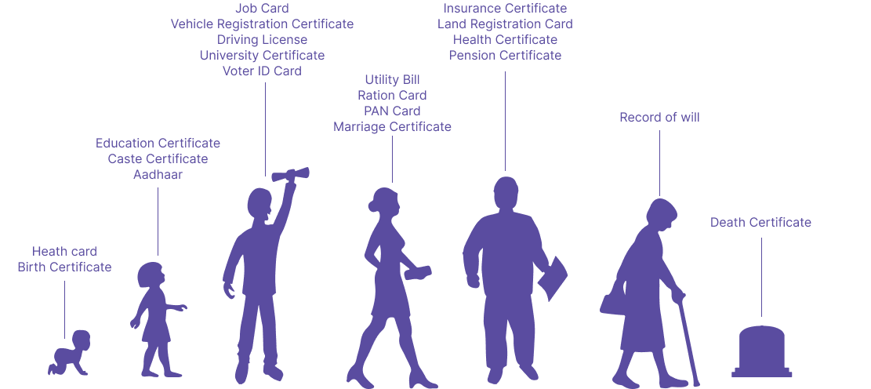
DigiLocker – Paperless Governance powering Ease of Living for All

Slide 4
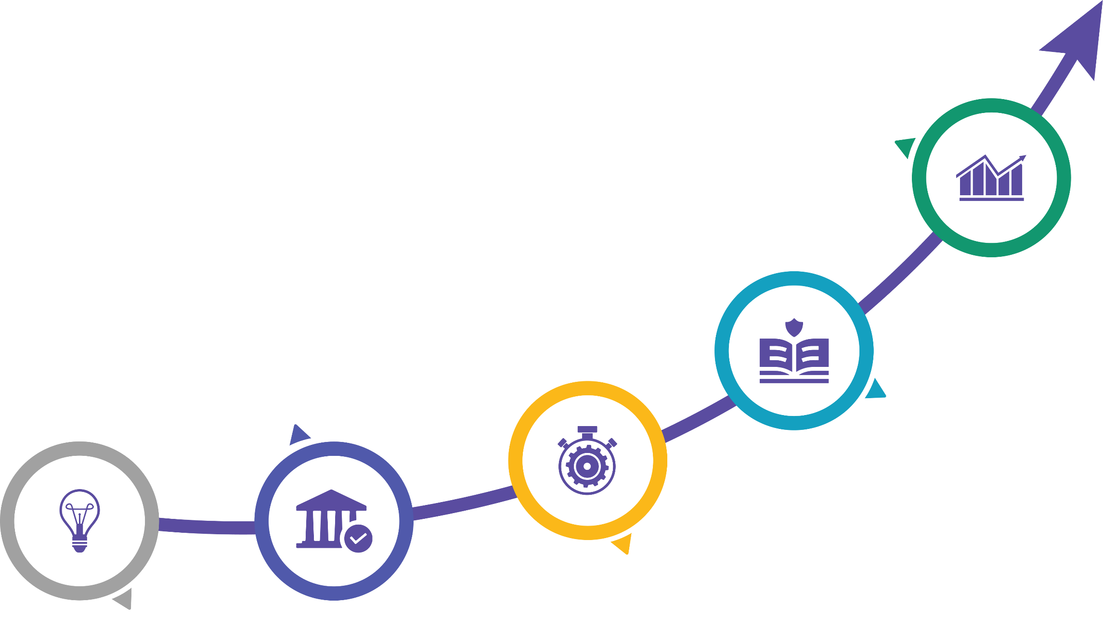
Journey so far
380M users with 7.76B documents available till 1-Dec 2024
Data Exchange & Verification Platform implemented in July 2017
OM from MoRTH for acceptance of DL, RC
Addendum for accepting photo identity by MOCA & MOR in 2018
Notified as sole NAD &
OM regarding Adoption of DigiLocker by DARPG in 2020
Amendment made to accept digital KYC documents through DigiLocker by PMLA in 2019 and RBI & SEBI in 2020
DigiLocker launched by PM in July 2015
DigiLocker Rules in IT Act in July 2016

Slide 5
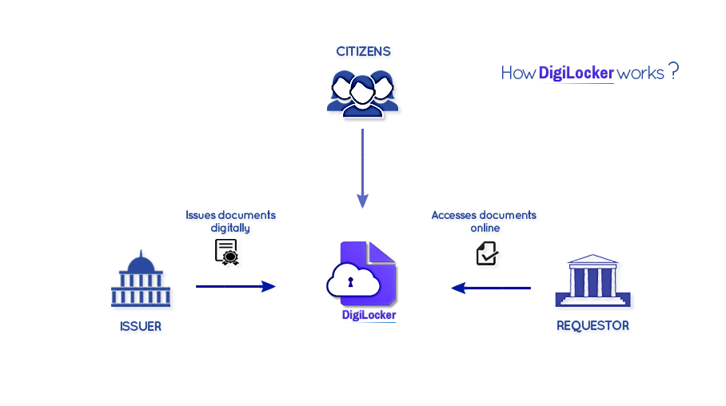
DigiLocker – Ecosystem
Authentic documents directly from Issuers
(Election Commission)
API
API
Consent, Security, Privacy

Slide 6
DigiLocker- Service Transformation
Citizens
Citizens
Citizens
Citizens
Citizens
Citizens
Government
Education
Finance
Employment
Health
DigiLocker App
Citizen Authentication
DigiLocker Accounts Service
Requestors = Consumers
Gateway (Oauth2 ,Consent , Security & Privacy)
Citizen auth success
Issuers = Publishers
AUTHENTICATION SERVER
Identity and KYC
Academic Services
Financial Services
Health Services
OAUTH TOKEN
Aadhaar
DL
Mark Sheets
Degrees
Bank Records
Insurance
Digilocker Repo 1
Health Repos
AUTHORIZATION SERVER
PAN
Passport
Certificates
Skills
Loans
Income Tax
Hospital 1
Hospital 2
Single Sign On
NREGS
PDS
*DigiLocker Federated Repositories
EPFO
E-PPO
Clinic
Lab

Slide 7
DigiLocker – Upcoming Features
Nomination Facility
Health Locker
Family Locker
Address Update Facility

Slide 8
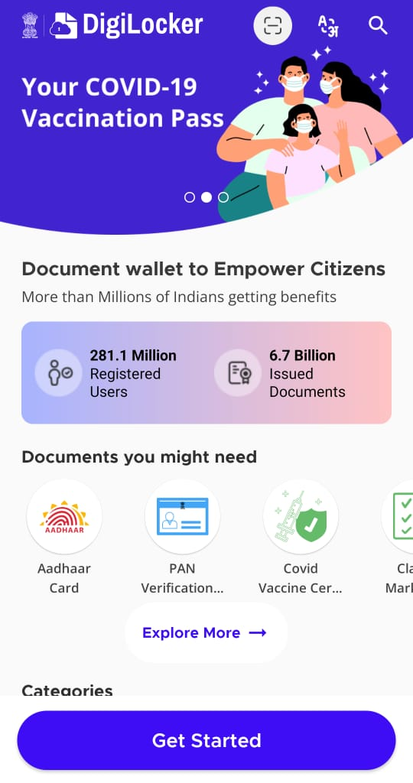
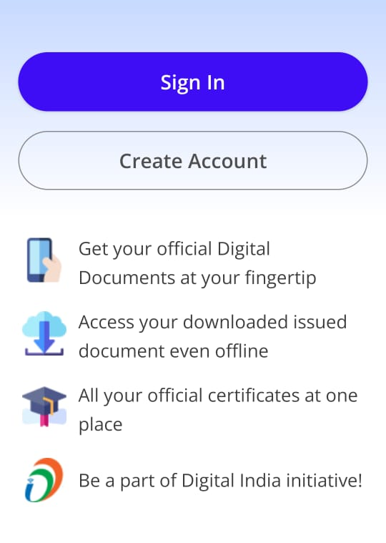
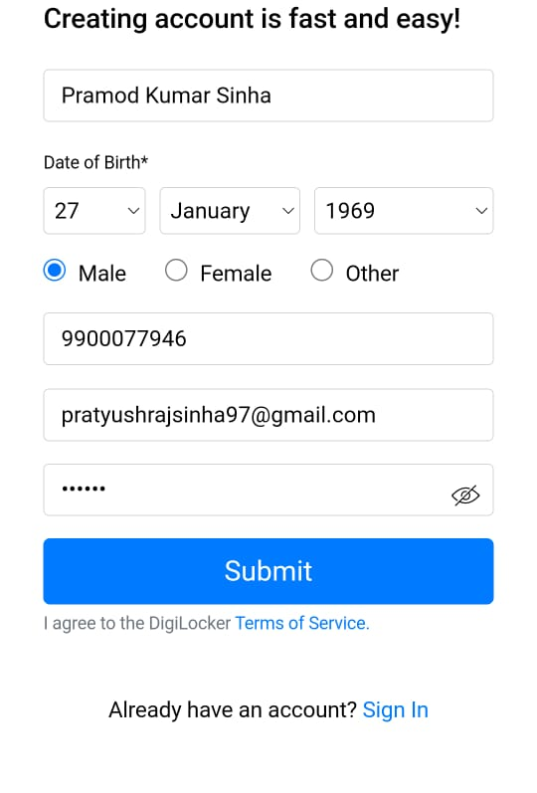
DigiLocker – How to create account

Slide 9
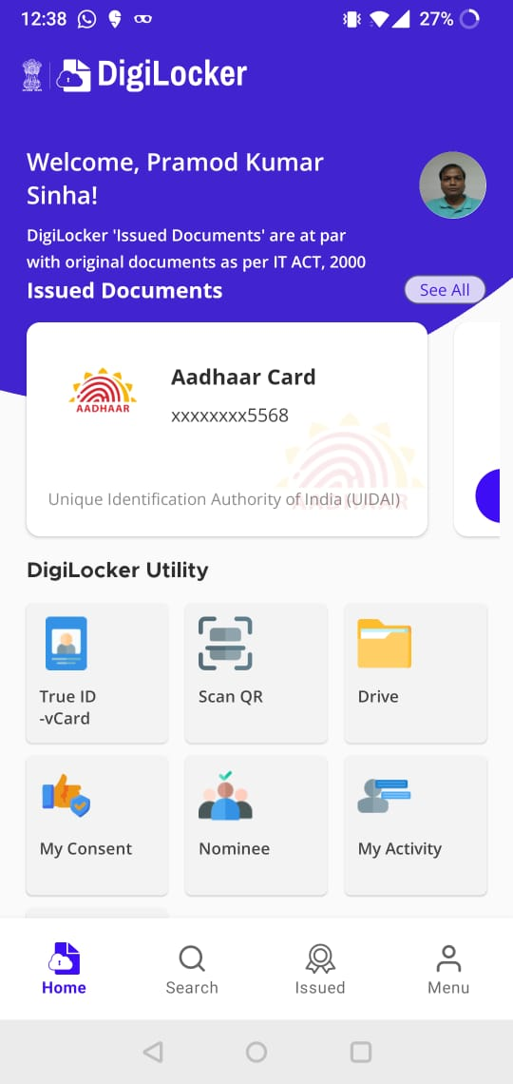
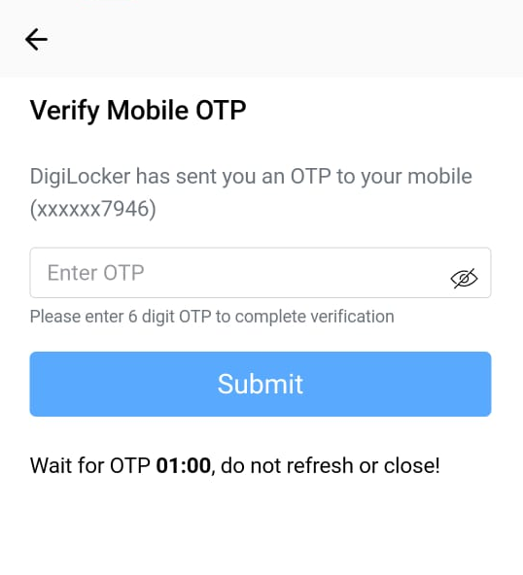
DigiLocker – How to create account…

Slide 10
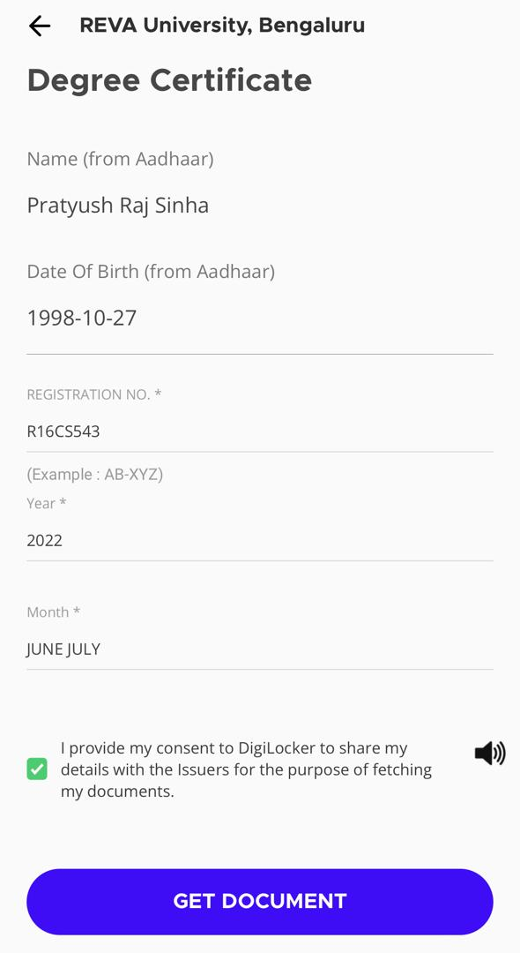
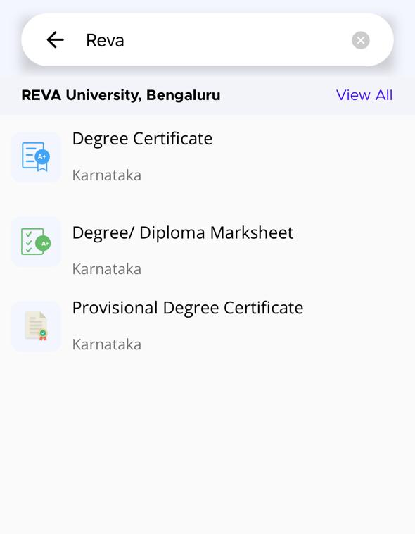
DigiLocker – How to search a document

Slide 11
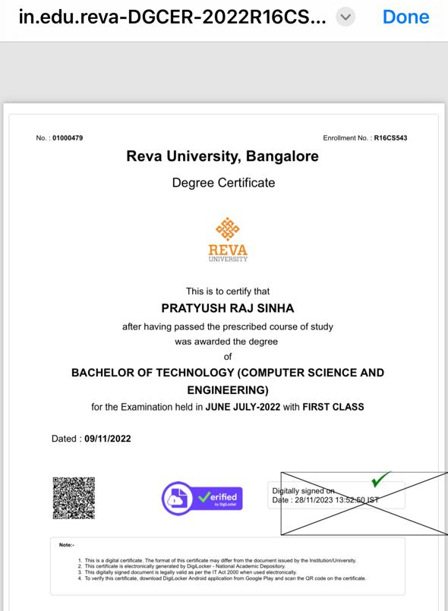
DigiLocker – How to search a document…

Slide 12
Thank you

